Slide 1
Memory

Slide 2
Bits and representation

Slide 3
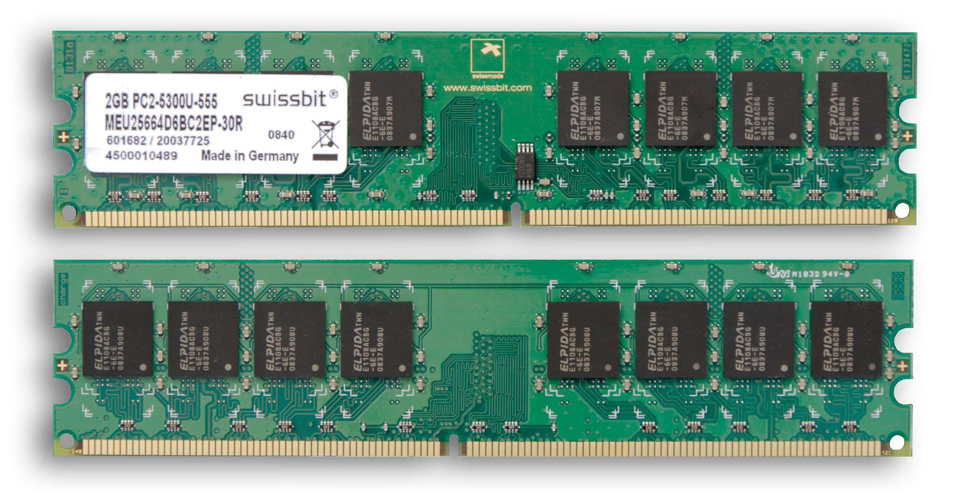
Memory

Slide 4
Integer
Bits | Base 10 (int3) 1’s complement | Base 10 (int3) 2’s complement | Base 10 (uint3)
000 | 0 | 0 | 0
001 | 1 | 1 | 1
010 | 2 | 2 | 2
011 | 3 | 3 | 3
100 | -3 | -4 | 4
101 | -2 | -3 | 5
110 | -1 | -2 | 6
111 | -0 | -1 | 7

Slide 5
Integer
Q1. What is the max integer in Python?
Q2. What is a long type?

Slide 6
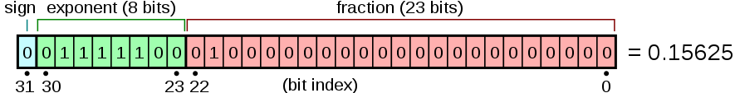
Float
Exponent is int8
(Like unsigned, but starts from -127):
4+8+16+32+64 -127 = -3
Fraction:
(1.01)₂
(1.01)₂ x 2⁻³ = (0.00101)₂= 2⁻³ + 2⁻⁵ = (0.15625)₁₀

Slide 7
Memory Address

Slide 8
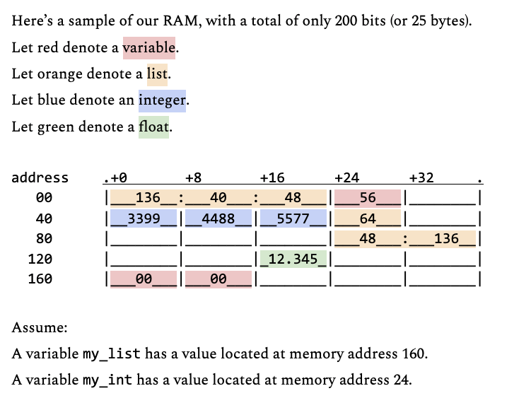
Notes:
Python ‘=‘ usually store data by pointer objects.

Slide 9
What is contained in my_list (position 160)?
What is contained in my_int? (position 24)
What does the list in position 64 look like?
Why does the index of a list begin with zero?

Slide 10
What is the difference between the following two commands?
[[] for _ in range(3)]
[[]] * 3?
Notes:
For the second item, it actually has 1 list
It only points to that list, and 3 lists reuse them (only pointers, not creating new lists)
[[],[],[]]
When we put 1 in one list ← x[0].append(1)
In the second item
It becomes [ [1], [1], [1]]

Slide 11
Memory management

Slide 12
Memory Leak
# Create an object, and operate
mCat = CrazyCat()
mCat.meow()
# Then I set mCat to something else
mCat = 1
Where is my crazy cat now?

Slide 13
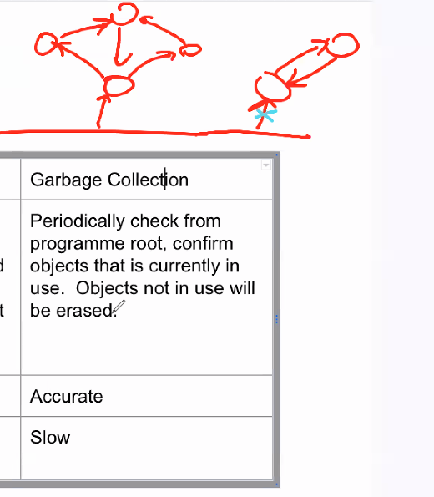
Solutions
 | Reference Counting | Garbage Collection
How | Every object created as a reference counter, counter +1 when an object is stored in a new variable, -1 when removed from a variable. It is erased from memory when counter reaches 0. | Periodically check from programme root, confirm objects that is currently in use. Objects not in use will be erased.
Pros | Fast | Accurate
Cons | Suffer from circular referencing | Slow
Notes:
Some memory may be wasted (memory leak) when there is circular referencing
For garbage collection, when garbage collection time comes, if the root is not connected to roots, it will erase the object memory. (prevent memory leak issue)

Slide 14
Takeaways

Slide 15
Checkpoint 1
In neural network models like ChatGPT and Stable Diffusion, it is very common to see half-float. Using half-float can reduce the model size by half (e.g. 6Gb → 3Gb). However, half float arithmetics are supported only in GPU but not in CPU, that is why we seldom see them in daily programming.
What is the meaning of int16, int32, int64?
What is the meaning of a 32-bit floating point number? There exist other floating point numbers like:
Double precision floating point number (64 bit)
Half floating point (16 bit)
How does the size of float affect programming?
In Python, integers are complex data structures, that is why it does NOT suffer from Integer overflow. This is also one of the reason why Python programs in general runs 10 times slower than C programs.
Notes:
The meaning of int16, in32, int64
https://doc.embedded-wizard.de/int-type#:~:text=Property%20reference-,Data%20types%3A%20int8%2C%20int16%2C%20int32,8%2C%2016%20or%2032%20bit.

Slide 16
Checkpoint 2
How would you describe a variable in Python?
A container
A pointer
Since a variable is a pointer, some properties thus exist:
Multiple variables referring to the same object
A list containing itself
Need to clean up objects that are no longer referred, otherwise memory-leak will happen
Notes:
In python everything is a pointer

